Slide 1
Notes keeper app

Slide 2
Objective
Note Keeping App: Everyone is currently extremely busy, which causes them to forget a lot things. As a result they need a system where they can record all of their critical notes so they can check them at any moment with a single click.
User-friendliness: Everyone should be able to utilize an app effortlessly, thus we’ll need on with an engaging and appealing user interface.
Benefits
Convenience: Notes can be easily created, edited and accessed from any device with an internet connection.
Synchronization: Notes are automatically saved and synced across devices
Security: Notes are stored securely on servers with encryption of sensitive information
Accessibility: Notes can be accessed from any device, making them useful for individuals who are constantly on the go
Flexibility: Notes can be edited and formatted in a variety of ways to suit different needs and preferences

Slide 3
Data requirement
Username
User Email
User Password
Notes
Title
Content
Created time
Updated time
Font color
Background color

Slide 4
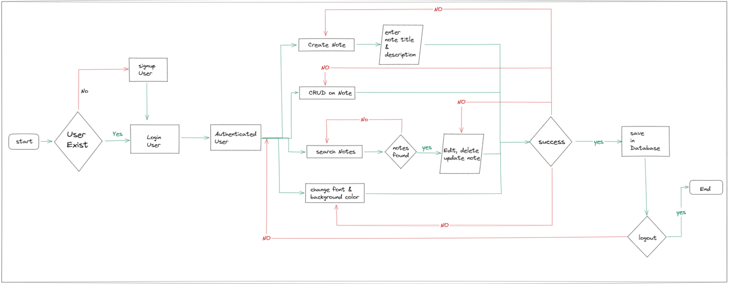
Architecture

Slide 5
Description of database design
Data model: Two main model i.e, user and Note model
Relationships: The note model has one to one relationship with user model
Data types: username, email, password, note title and note content belong to string data types, updated, created belong to dates object and id which belong to object id datatypes.
Security: bcryptjs, jsonwebtoken and dotenv are used.
Scalability: mongoDB database is a scalable database.

Slide 6
Description of user interface design
User experience (ux): the user experience is built using ReactJs which is modern JavaScript library for creating user interface.
UI Elements – some of the UI elements includes signup button, login button, search input field with search button, notes input field, add update button, change font and background color with color input field.
Layout and navigation: the system of navbar , note creation and note container field.
Responsiveness: the system is made responsive for both mobile and desktop screen size.
Error handling: every error in the system is display using react-toastify.

Slide 7
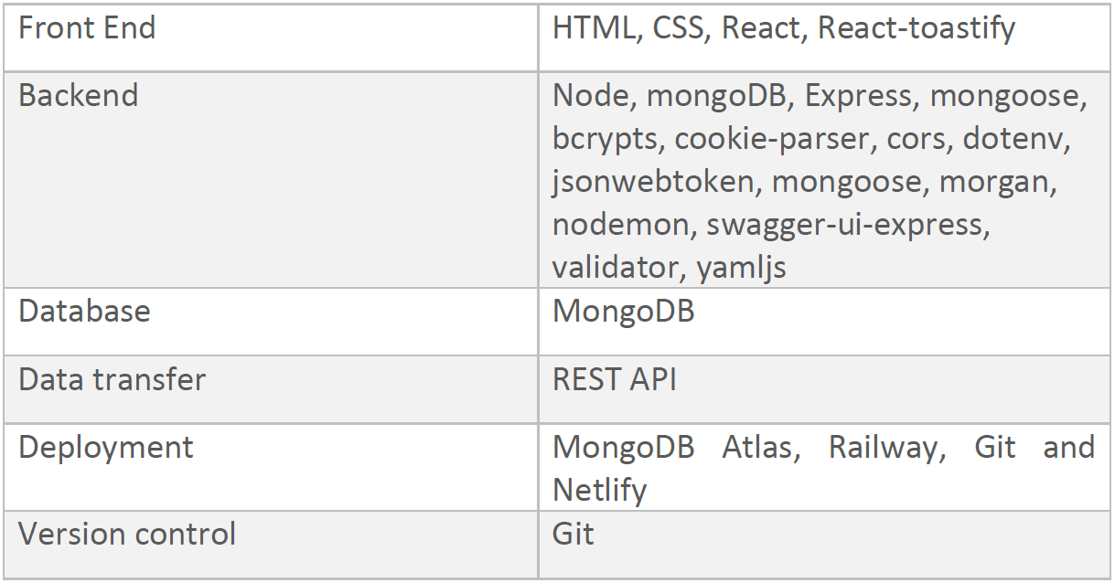
Technology stack
The system is built with MERN stack, however details of libraries and frameworks are shown below in the table

Slide 8
Q & A
What Is Notes keeping Applications
A notes keeping app is a digital tool used to organize and store notes, ideas and information
What are the benefits of using notes keeping Applications
The benefits include accessibility of notes, the ability to search and the ability to access notes from multiple devices
How does a Notes keeping application work
It typically allow users to create, edit and store notes in a digital format and provide tools for searching and retrieving notes
Is a notes keeping application the same as a to-do list application
While both types of applications can be used similar purpose, a notes keeping application generally has a broader focus and may include more comprehensive organizational tools. A Todo-list application is more focus on tracking tasks and deadlines.

Slide 9
Q & A
Is it necessary to have internet connection to use a notes application.
The application is a web base application so internet connection is a must. The user wont be able to access without internet connectivity.
What are some of the features can be added in future.
Some of the features includes
Note tag name or category
Add Task with date features functionality

